Slide 1




My Algebra Interactive Notebook
$$3ab$$
$$2x+3y$$
$$\frac{5xy}{6}$$
Name :
Class :
Term 2 Semester 1
$$y=2x+1$$

Slide 2
Contents
Glossary
Page
Date
Description
2
3

Slide 3
Tasks
24
7
30
Essential Question
Questions
Notes
Summary
4
7

Slide 4
24
7
30
Date
Factorising Expressions
EQ – How do I use the HCF to factorise expressions?

Slide 5
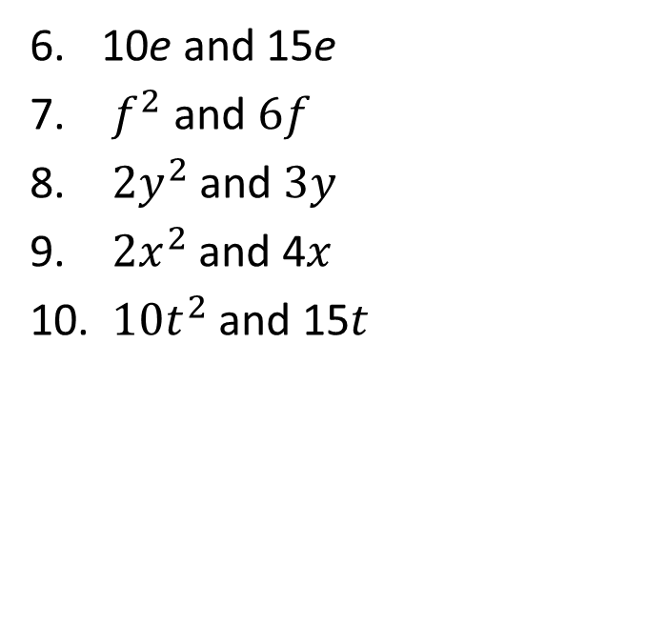
Task
Find the HCF of the following
2 and 4
10 and 15
2a and 6
10a and 15b
2c and 3c
10e and 15e
$f^{2}$ and $6f$
${2y}^{2}$ and $3y$
$2x^{2}$and 4$x$
$10t^{2}$and 15$t$

Slide 6
24
7
30
Date
Factorising Expressions
EQ – How do I use the HCF to factorise expressions?
What is the HCF?
HCF – Highest Common factor

Slide 7

24
7
30
Date
Factorising Expressions
EQ – How do I use the HCF to factorise expressions?
What is the HCF?
HCF – Highest Common factor
How do I factorise?
Factorise $2p+10$

Slide 8
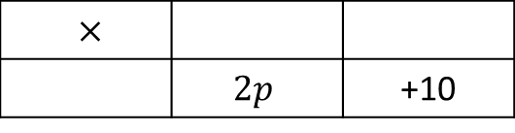
24
7
30
Date
Factorising Expressions
EQ – How do I use the HCF to factorise expressions?
What is the HCF?
HCF – Highest Common factor
How do I factorise?
Factorise $2p+10$
$×$
 | $$2p$$ | +10
Find the HCF of both terms

Slide 9
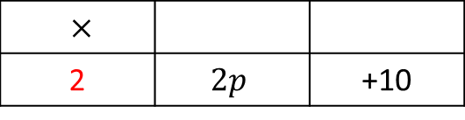
24
7
30
Date
Factorising Expressions
EQ – How do I use the HCF to factorise expressions?
What is the HCF?
HCF – Highest Common factor
How do I factorise?
Factorise $2p+10$
$×$
2 | $$2p$$ | +10
Find the HCF of both terms

Slide 10
24
7
30
Date
Factorising Expressions
EQ – How do I use the HCF to factorise expressions?
What is the HCF?
HCF – Highest Common factor
How do I factorise?
Factorise $2p+10$
Divide terms by HCF
$×$
2 | $$2p$$ | +10
Find the HCF of both terms

Slide 11
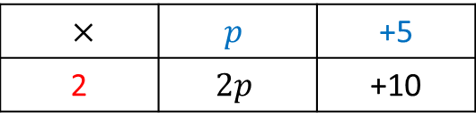
24
7
30
Date
Factorising Expressions
EQ – How do I use the HCF to factorise expressions?
What is the HCF?
HCF – Highest Common factor
How do I factorise?
Factorise $2p+10$
Divide terms by HCF
$×$ | $$p$$ | +5
2 | $$2p$$ | +10
Find the HCF of both terms
Write the expression using brackets

Slide 12

24
7
30
Date
Factorising Expressions
EQ – How do I use the HCF to factorise expressions?
What is the HCF?
HCF – Highest Common factor
How do I factorise?
Factorise $2p+10$
Divide terms by HCF
$×$ | $$p$$ | +5
2 | $$2p$$ | +10
Find the HCF of both terms
Write the expression using brackets
$$2(p+5)$$

Slide 13

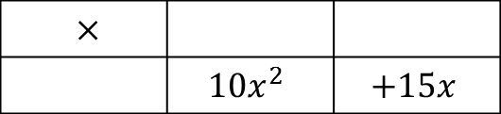
24
7
30
Date
Factorising Expressions
EQ – How do I use the HCF to factorise expressions?
What is the HCF?
HCF – Highest Common factor
How do I factorise?
Factorise $2p+10$
Divide terms by HCF
$×$ | $$p$$ | +5
2 | $$2p$$ | +10
Find the HCF of both terms
Write the expression using brackets
$$2(p+5)$$
Factorise $10x^{2}+15x$
$×$
 | $$10x^{2}$$ | $$+15x$$

Slide 14
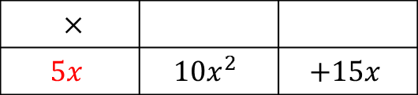
24
7
30
Date
Factorising Expressions
EQ – How do I use the HCF to factorise expressions?
What is the HCF?
HCF – Highest Common factor
How do I factorise?
Factorise $2p+10$
Divide terms by HCF
$×$ | $$p$$ | +5
2 | $$2p$$ | +10
Find the HCF of both terms
Write the expression using brackets
$$2(p+5)$$
Factorise $10x^{2}+15x$
$×$
$$5x$$ | $$10x^{2}$$ | $$+15x$$

Slide 15
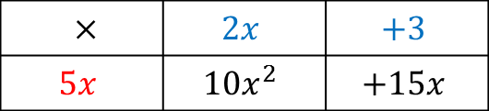
24
7
30
Date
Factorising Expressions
EQ – How do I use the HCF to factorise expressions?
What is the HCF?
HCF – Highest Common factor
How do I factorise?
Factorise $2p+10$
Divide terms by HCF
$×$ | $$p$$ | +5
2 | $$2p$$ | +10
Find the HCF of both terms
Write the expression using brackets
$$2(p+5)$$
Factorise $10x^{2}+15x$
$×$ | $$2x$$ | $$+3$$
$$5x$$ | $$10x^{2}$$ | $$+15x$$

Slide 16

24
7
30
Date
Factorising Expressions
EQ – How do I use the HCF to factorise expressions?
What is the HCF?
HCF – Highest Common factor
How do I factorise?
Factorise $2p+10$
Divide terms by HCF
$×$ | $$p$$ | +5
2 | $$2p$$ | +10
Find the HCF of both terms
Write the expression using brackets
$$2(p+5)$$
Factorise $10x^{2}+15x$
$×$ | $$2x$$ | $$+3$$
$$5x$$ | $$10x^{2}$$ | $$+15x$$
$$10x^{2}+15x=5x(2x+3)$$

Slide 17
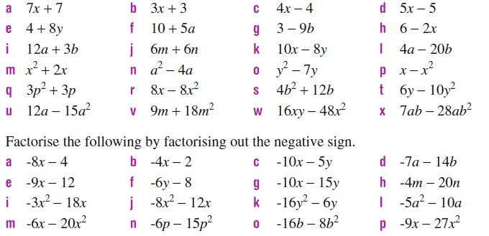

Slide 18
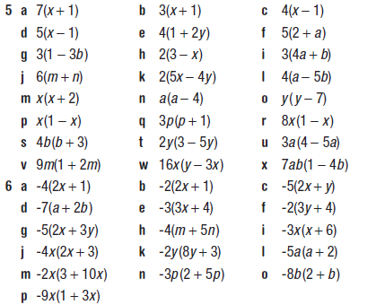

Slide 19
Notes Review
24, 7 ,30
Date
Title
Essential question
Notes complete
Notes complete with colour and diagrams
Questions completed
Contents page filled in
Formula page filled in

Slide 20
Homework
Review your notes and write a summary answering the essential question.

